Slide 1
MuHAMMAD MUJTABA ( 18I-0623 ) Muhammad umair khan ( 18k-1292 ) YUSHA FARID ( 18k-1289 ) Muhammad ahmed ( 18k-0256 )
MICRO ECONOMICS PRESENTATION

Slide 2
WALL STREET
TOPIC OF PRESENTATION :
CONTENTS:
INTRODUNCTION TO WALL STREET.
EARLY HISTORY OF WALL STREET.
ROLE OF WALL STREET.
TRADING WALL STREET.
CRASHES ON WALL STREET.
HOUSING MARKER CRASH
WALL STREET BULL
CONCLUSION.

Slide 3
WHAT?

Slide 4
Early History of Wall Street
Wall Street gets its name from a literal, physical wall built in New York when the town was still a Dutch colony. Governor Peter Stuyvesant called for a 10-foot wall to be built, protecting the lower part of the peninsula from Native Americans.
Later on, the street became known for being a marketplace where traders and buyers met to conduct business. In 1792, the traders and buyers formalized rules to authorize and legitimize their business, leading to the eventual formation of the NYSE.

Slide 5
trading on WALL STREET:
Trading on all types of markets, including the stock and bond markets that comprise Wall Street, involves a multitude of factors and mechanisms that affect prices. You will find market makers that are central to all trading exchanges. These market makers, also known as broker-dealers, are integrated into the trading system to facilitate the flow of money and trades.

Slide 6
Role of Wall Street
To establish a market for institutions to raise capital through a centralized trading area that connects savers of capital with those who want to raise capital.
To facilitate a secondary market for existing owners of stocks and bonds to find parties willing to buy their securities so they can raise cash.
To assist those who wish to outsource the job of investing their capital so the client can focus on their primary career or activity.

Slide 7
Wall Street Crash of 1929
The Wall Street Crash of 1929, also known as the Great Crash.
Most devastating stock market crash in the history of United States.
There’s not one specific explanation of what precisely triggered the massive stock sell-off in the fall of 1929.

Slide 8
Aftermath
Losses destroyed confidence in the economy
People believed the stock market was the economy
Investors abandoned the stock market
Banks were forced to close

Slide 9
Housing Market Crash (2008)
Housing prices started to fall.
The housing market crash was the result of the collapse of hundreds of billions of dollars.
Federal government bailing out Wall Street with the TARP program in 2008.

Slide 10
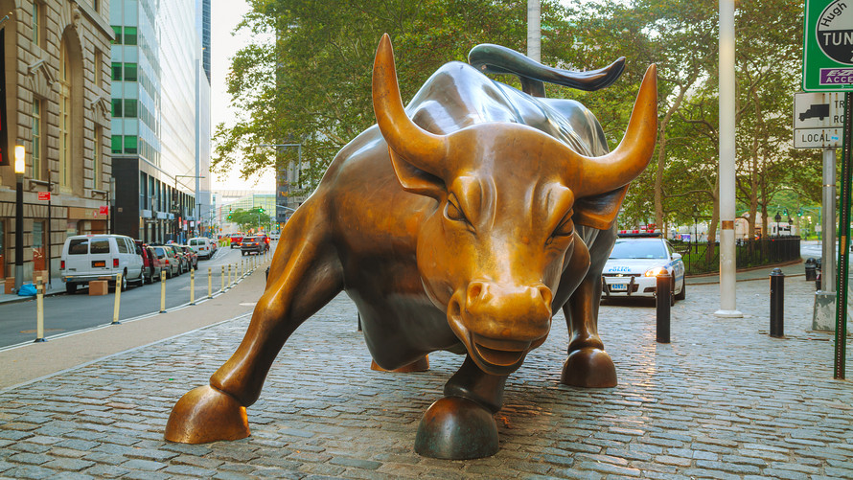
WALL STREET BULL
The Wall Street bull is a statue that symbolizes Wall Street. A bull market is when stock prices rise, and is considered more profitable than a bear market, although savvy Wall Street traders can make money in any market. The Wall Street bull has been moved off of Wall Street to 26 Broadway.
“ WALL STREET’s CHARGING BULL STATUE “

Slide 11
CONCLUSION?
WORLD’S LARGEST STOCK EXCHANGE: The New York Stock Exchange on Wall Street, the world's largest stock exchange per market capitalization of its listed companies.
ECONOMICAL IMPORTANCE: One estimate was that Wall Street firms employed close to 200,000 persons in 2008. Another estimate was that in 2007, the financial services industry which had a $70 billion profit became 22 percent of the city's revenue.

Slide 12
REFERENCES:
https://corporatefinanceinstitute.com/resources/knowledge/finance/wall-street/
https://en.wikipedia.org/wiki/Wall_Street#In_the_New_York_economy
https://www.thebalance.com/wall-street-how-it-works-history-and-crashes-3306252
https://en.wikipedia.org/wiki/New_York_Stock_Exchange

Slide 13
THANK YOU!

